Slide 1

Obtain appropriate informed consent
Janet Salmons, PhD

Slide 2

Obtain appropriate informed consent
Informed consent describes the actual agreement as well as the process researchers engage in to ensure that individuals are informed about the study before they voluntarily agree to participate.

Slide 3
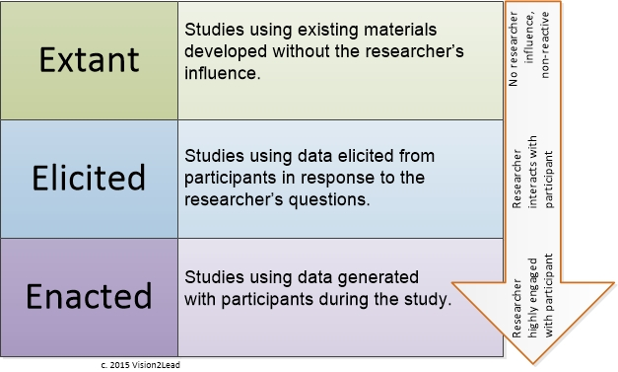
Consent in studies using Extant, Elicited or Enacted Methods

Slide 4
Informing participants before the study
Introduce yourself
Generate interest in study participation
Communicate specifics about time, technology access or other requirements
Let potential participants know what you need to achieve purpose
Reassure potential participants about protection of data, anonymity, etc.

Slide 5
Informing participants during the study
Reminders about follow-up interviews, observations or member checking
Address any changes in the study that vary from those in original consent agreement
Signal emergent directions such as new questions to discuss in follow-up interviews or observations
Reiterate use of data in publications or presentations

